Slide 1
Object-Oriented Analysis and Design using JAVA
B.Tech (CSE/IT) 5th SEM
2020-2021
Lecture-21 Activity diagram Objects

Slide 3
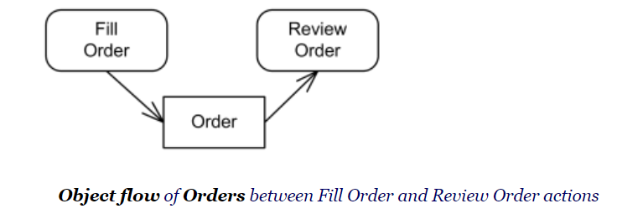
Objects
An object node is an abstract activity node that is used to define object flows in an activity.

Slide 4
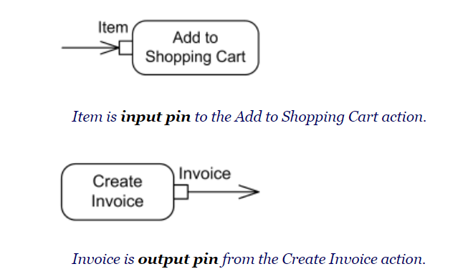
Pin

Slide 5
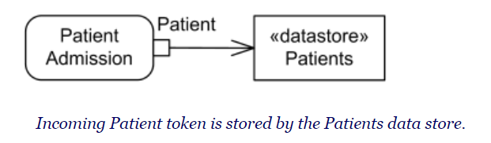
central buffer

Slide 6
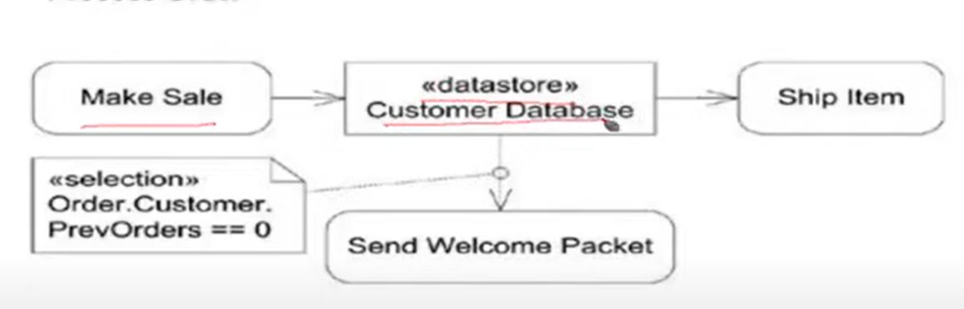
Process Order

Slide 7
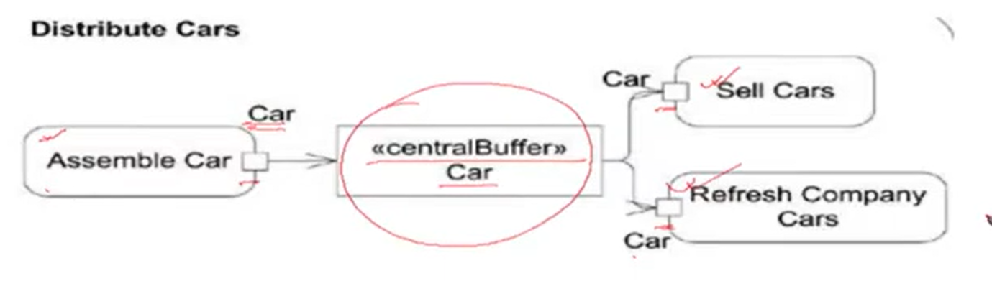
Distribute cars

Slide 8
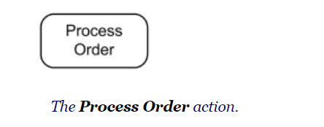
Actions
Action is a named element which represents a single atomic step within activity, i.e. that is not further decomposed within the activity. Activity represents a behavior that is composed of individual elements that are actions.

Slide 9
Name of the action is usually action verb or noun for the action with some explanation. Don't use state names as action names. Some action name examples:
Fill Order
Review Document
Enroll in Course
Checkout
Show Error Page

Slide 10
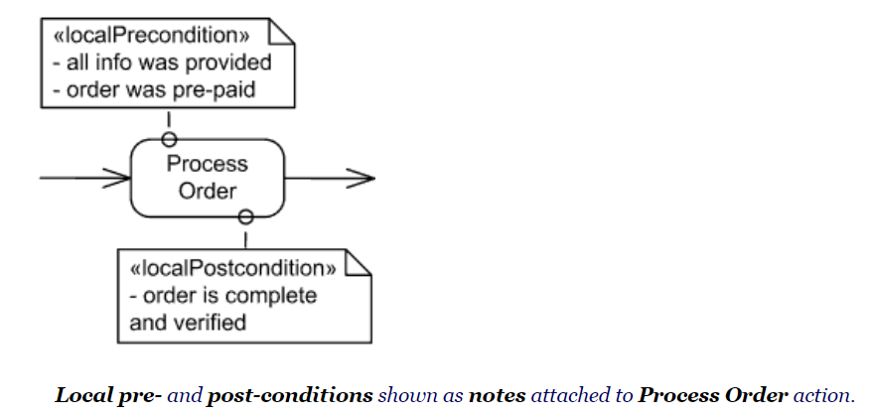
Conditions
Local pre-conditions and local post-conditions are constraints that should hold when the execution starts and completes, respectively

Slide 11
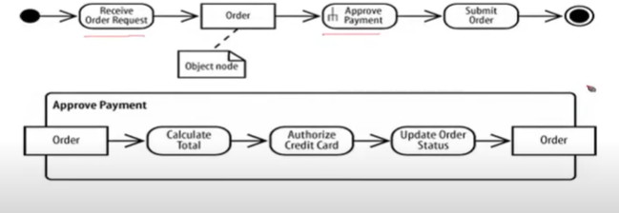
Example

Slide 12
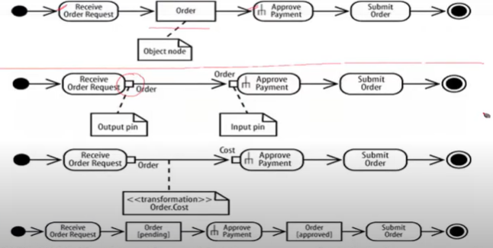

Slide 13
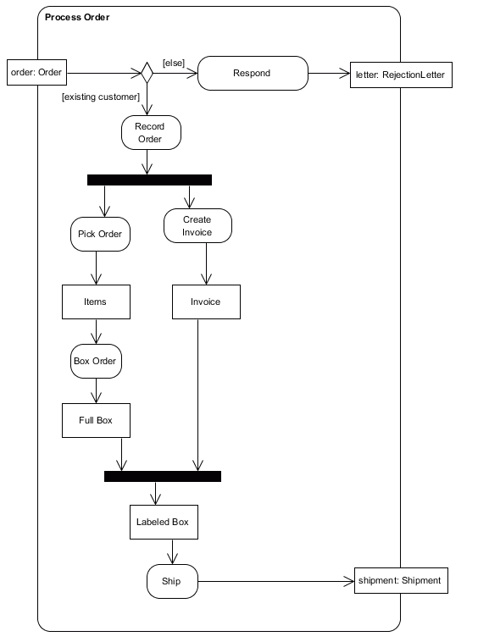
Activity diagram
Identify all of the activities in this diagram.
Identify all of the object/data nodes in this diagram.
Identify all of the actions in this diagram.
Identify all of the decision nodes in this diagram.
Identify all of the fork nodes in this diagram.
Identify all of the join nodes in this diagram.
Identify a control flow in this diagram.
Identify a data flow in this diagram.
Reference: https://w3.cs.jmu.edu/bernstdh/Web/CS345/study-aids/exam1-sample.php

Slide 14
Key references
Unified Modeling Language (UML): Complete Guide & Examples
-By James Rumbaugh, Ivar Jacobson, Grady Booch
https://www.guru99.com/uml-activity-diagram.html
https://www.uml-diagrams.org/activity-diagrams-examples.html

Slide 15
Thank You

